Slide 1
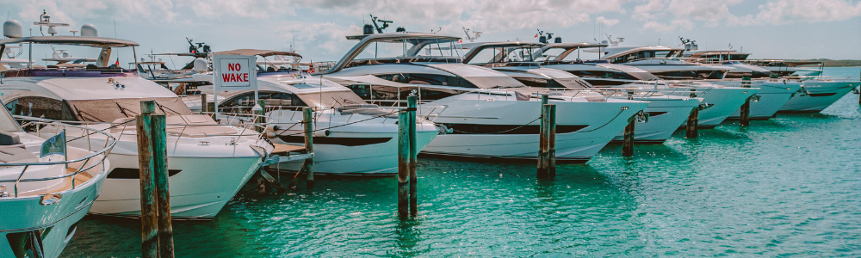
Moffat Bay Island Marina
By Group 2.

Slide 2
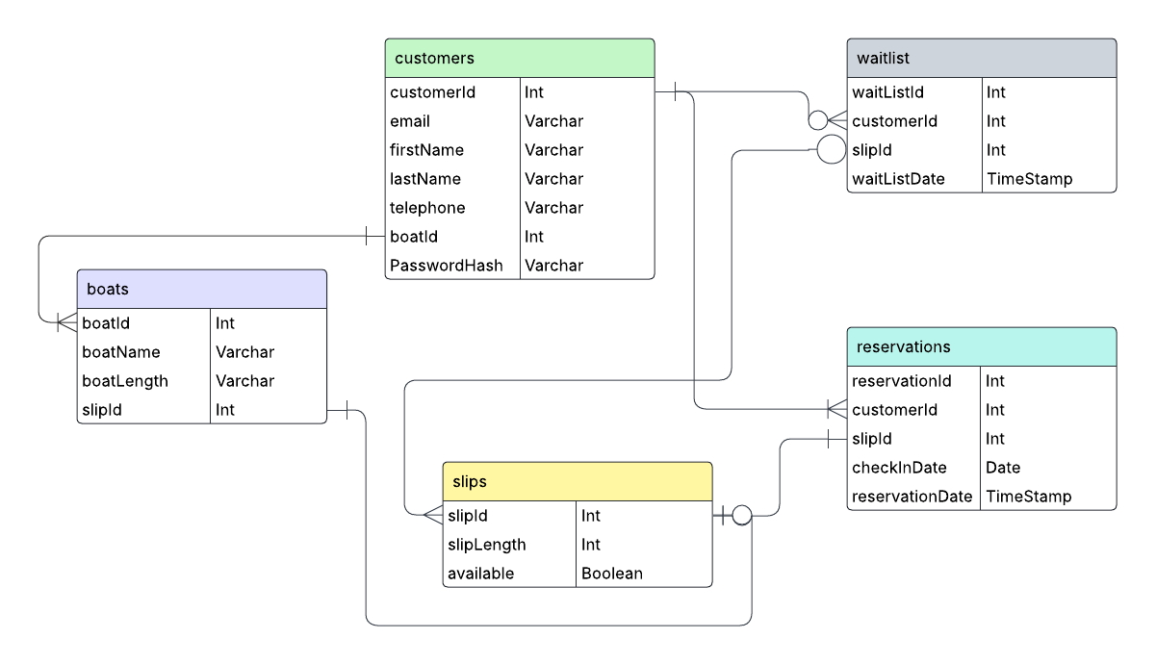
Assignment 4.1
Moffat Bay: ERD Assignment
Database: moffat_bay_marina

Slide 3
